Slide 1
WELCOME
TO MY PRESENTATION
ARTIFICIAL INTRLLIGENCE

Slide 2
CONTeNT
What is artificial intelligence?
Application of AI
Type of artificial intelligence
Advantage of AI
Disadvantage of AI

Slide 3
ARTIFICIAL INTELLIGENCE
It is branch of computer science by which we can create intelligent machine which can behave like a human think like human and able to make decisions.

Slide 4
EVOLUTION OF AI
The term artificial intelligence was first coined decades ago in the year by john McCarty at the Dartmouth conference he defined
“Artificial Intelligence as science an engineering of making intelligent machines to work & behave like human.

Slide 5
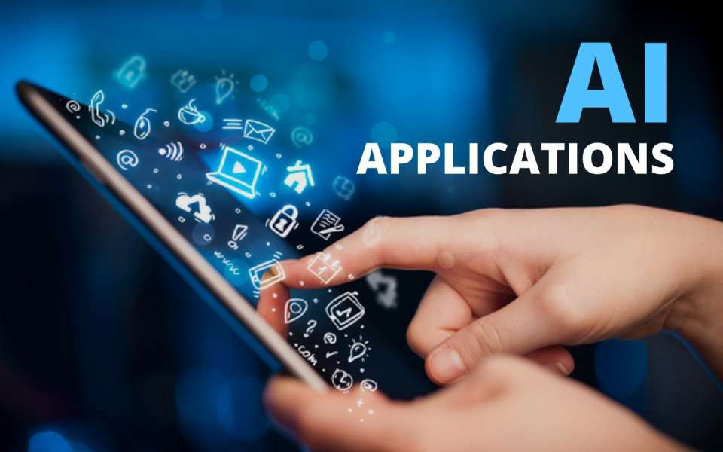
APPLICATION OF AI
  ROBOTICS
  HEALTH CARE
  SOCIAL MEDIA

Slide 6

ADVANTAGE OF AI
Reduction in human error
Takes risks instead of humans
Available 24*7
Helping in repetitive jobs
Digital Assistance
Faster decisions
Daily application
New inventions

Slide 7
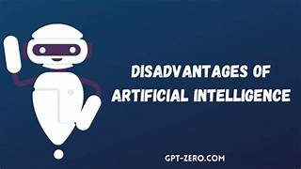
DESADVANTAGE OF AI
High cost
No creativity
Unemployment
Make human lazy
Emotionless
No improvement

Slide 8
Thank you

